Slide 1
AN ONLINE AUCTIONING PLATFORM
:

Slide 2
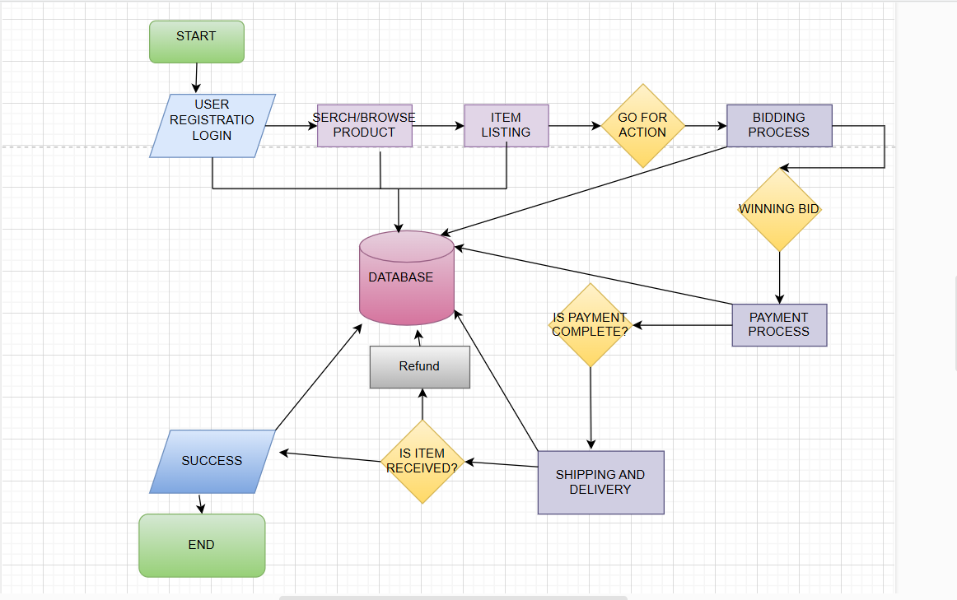
FLOWCHART

Slide 3
DFD
EXTERNAL ENTITIES:
Users(buyers and sellers)
Admin panel
PROCESSES
User registration/login
Search and Browse product
Bidding process
Payment process
Shipping and delivery
Feedback and Reviews
Buyer-seller Messaging
Notifications and Alerts
Admin monitoring and Frauds Detection

Slide 4
Datastores/databases
User database-Store login credentials profile information
Product database-store listed items
Bidding database-tracks active bids and winning bids
Payment database-stores transaction details
Review database-holds feedback and ratings
Admin Analytics and Reports-Stores fraud detection and reports
Data flows:
User register and login, storing credentiasl in the user database.
Seller lists products, which go into the product database
Buyer browse products and place bids ,updating the bidding database
When a auction ends , the winning bid is recorded ,triggering payment processing
Payment confirmation updates the shipping databse
Reviews and feedback are submitted and stored
Admin monitor activites ,fraud detection processes ,and analytics are generated.

Slide 5
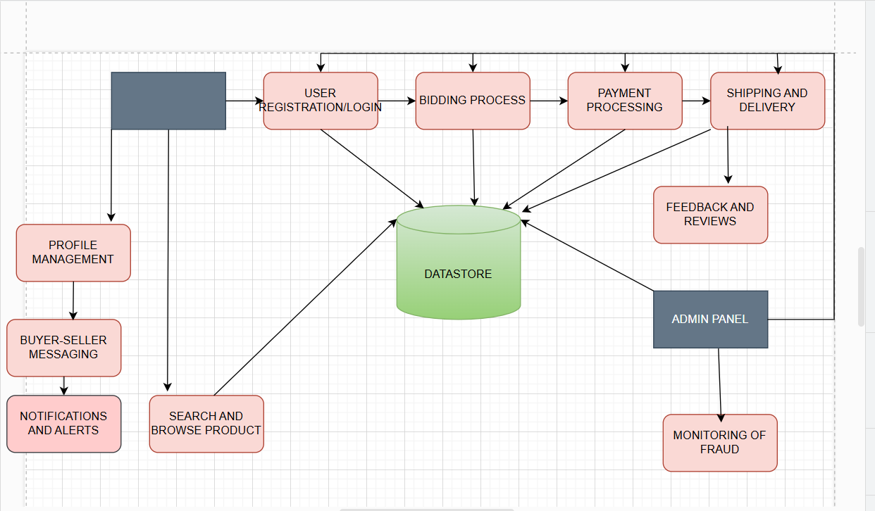
DATA FLOW DIAGRAM

Slide 6
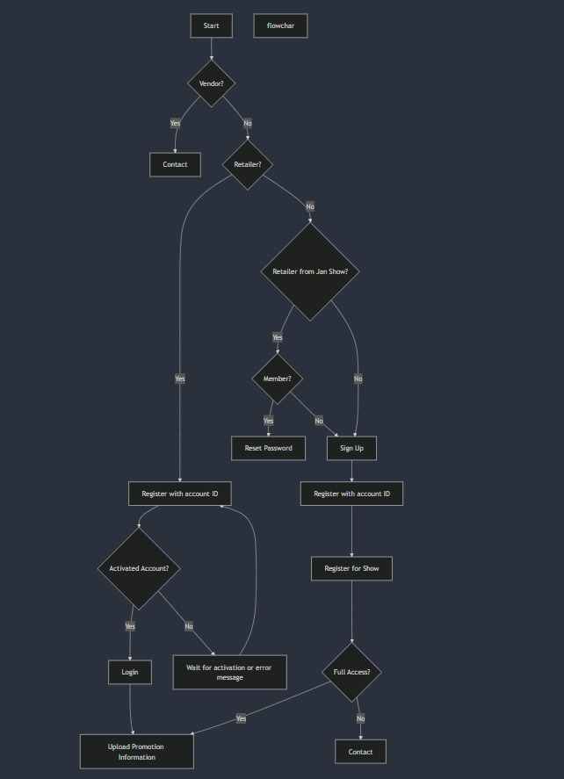
Flowchart👌👍

Slide 7
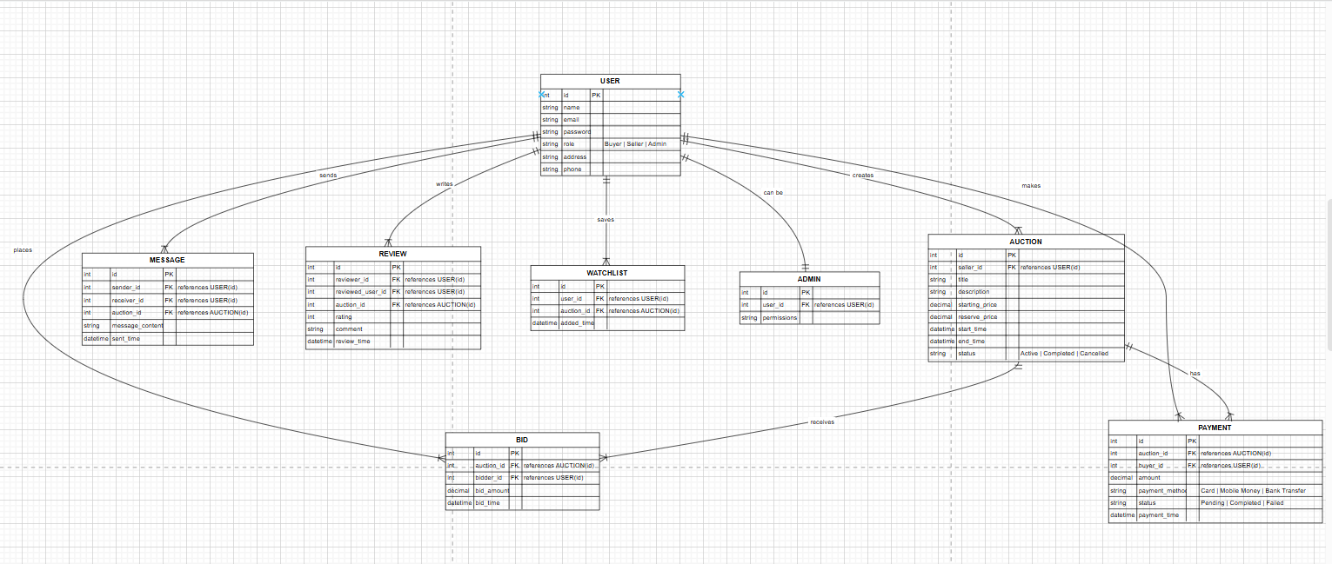
ENTITY RELATIONSHIP DATABASE

Slide 8
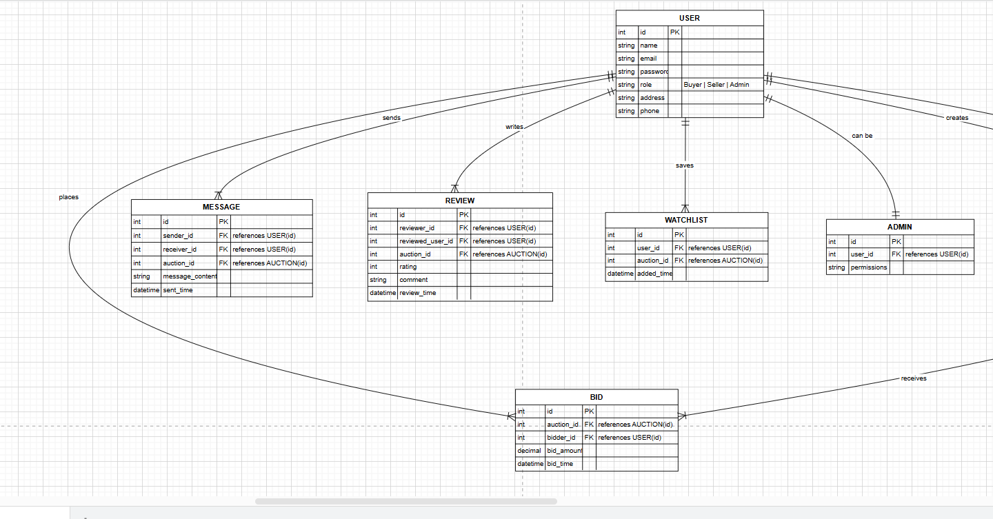
ERD

Slide 9
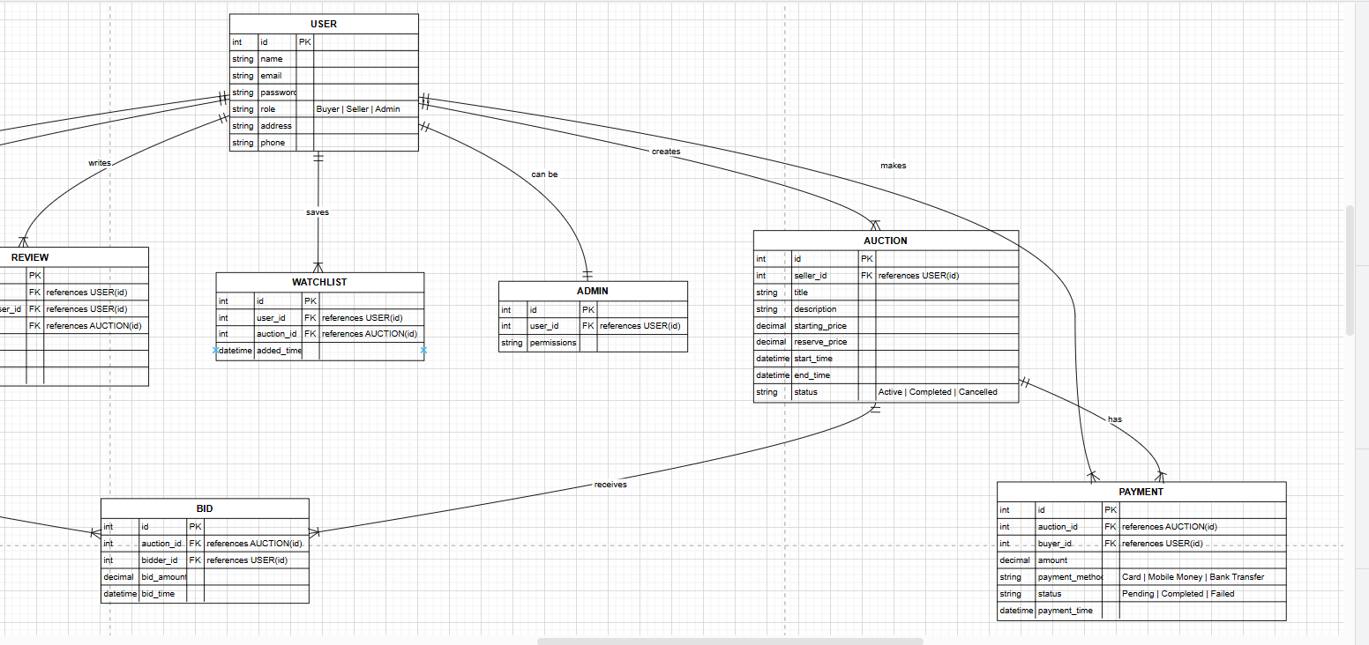
ERD

Slide 10
Relationship summary
User (1) --- (M) Auction
User (1) --- (M) Bid
User (1) --- (M) Payment
User (1) --- (M) Message
User (1) --- (M) Review
User (1) --- (M) Watchlist
User (1) --- (1) Admin (Optional)
Auction (1) --- (M) Bid
Auction (1) --- (1) Payment
Auction (1) --- (M) Message
Auction (1) --- (M) Review
Auction (1) --- (M) Watchlist
Bid (M) --- (1) Auction
Payment (1) --- (1) Auction
Message (M) --- (1) Auction
Review (M) --- (1) Auction
Watchlist (M) --- (1) Auction

Slide 11
This relational model ensures that:
✅ Users can bid on multiple auctions. ✅ Auctions can have multiple bidders. ✅ Users can send messages regarding auctions. ✅ Payments are securely linked to auctions. ✅ Reviews are associated with users and auctions. ✅ Users can track auctions with a watchlist. ✅ Admins have additional control over the system.

